Slide 1

Customer Segmentation & Sales Forecasting
Priyanka Sangam
Maninderjit Sohal
Sumiya Aamir

Slide 2

Introduction
Sales forecast is a common business practice.
Forecasting is essential for Business of any size to manage Production, Inventory or Finance
Online shopping trend - from around 1% of retail sales in 2000 to close to 16% in 2019
We selected an open source Online Retail Dataset from UCI Repository which originally consists of 1,067,371 records

Slide 3
Objectives
Customer segmentation - RFM Model
Predicting sales - In terms of Quantity (Units sold)
Predicting sales - In terms of Cost (Revenue generated)
Price formation - each product is sold with different price
Different prices for different customers
Based on offers/discount

Slide 4
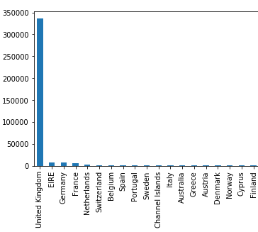
Exploratory Data Analysis
THE DATASET CONTAINS TRANSACTIONS FOR A UK-BASED, NON-STORE ONLINE RETAIL
THE COMPANY MAINLY SELLS UNIQUE ALL-OCCASION GIFT-WARE
THE PRODUCTS WERE SHIPPED TO DIFFERENT COUNTRIES – 40 COUNTRIES FOUND. UK HAVING THE HIGHEST NUMBER OF CUSTOMERS
QUANTITY & PRICES - RETURNS MARKED WITH NEGATIVE VALUES
STOCK CODE – IRRELEVANT VALUES SUCH AS TEST, POST, ETC.
PRICE - SAME PRODUCTS HAVE DIFFERENT UNIT PRICE – SUGGESTS DISCOUNT/OFFERS
CUSTOMER ID - SAME CUSTOMER ID FOR TWO DIFFERENT COUNTRIES - DUPLICATE CUSTOMERS

Slide 5

Customer Segmentation
Clustered the data using KMeans - 3 clusters – Helpful in creating marketing strategies
Found three clusters – Cluster 0 -bigger percentage of them were ordinary shoppers with reasonable spending
Cluster [1] customers represents medium to high profit
Cluster[2] customers were extremely highly profit customers

Slide 6
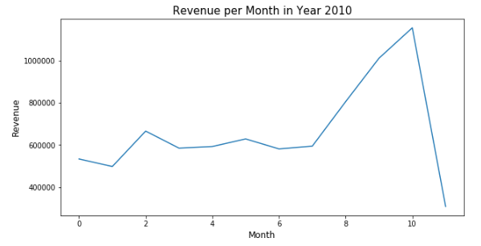
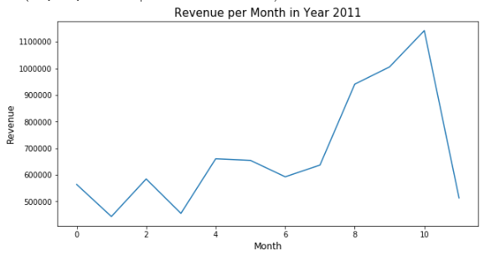
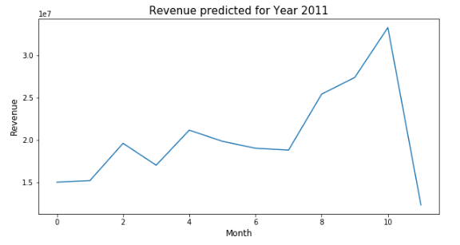
Sales Predictions
Split Data - Train set (2010), Test set (2011)
Highest Revenue is generated between September to November
Models
Linear Regression
Decision Tree Regressor
Ridge, Lasso and Elastic Net Regression

Slide 7

Conclusions
Decision Tree Regressor performed slightly better than other models
In this Project, we were able to Predict Revenue generated per month and perform customer segmentation
Future work can consist of offering Customized Prices to Targeted Customers

Slide 8
References
Chen, D. Sain, S.L., and Guo, K. (2012), Data mining for the online retail industry: A case study of RFM model-based customer segmentation using data mining, Journal of Database Marketing and Customer Strategy Management, Vol. 19, No. 3, pp. 197-208. doi:
Dataset Link https://archive.ics.uci.edu/ml/datasets/Online+Retail+II
https://econsultancy.com/stats-show-online-retail-ecommerce-changing/
https://www.infoentrepreneurs.org/en/guides/forecast-and-plan-your-sales/

Slide 9

Questions?

